Slide 1

Employee Attrition Case Study Akbar Thobani DDS 6306

Slide 2
Introduction
DDS Analytics has tasked us with to uncover insights and trends specific to Job Roles within the company and how those factors contribute to turnover/attrition.
Method:
Using R analyze employee attrition data and find insights
Project Deliverables :
Any trends related to Job Role
Build a classification model to predict attrition with a minimum accuracy of 60%
Build regression model with RMSE < $3000
Generate prediction for provided datasets
What are the top 3 factors that lead to turnover

Slide 3
Exploratory Data Analysis
More than 80% of the training dataset consist of employees who are still retained
Sales Executives make up 23% of the total labor force followed by Research Scientist 19% and Lab Tech at 17%

Slide 4
Job Role And Attrition
Job Role by % of Total
% wise Sales Representative, Sales Executive, Research Scientist and Lab Technician all seems to have high attrition rate

Slide 5
Co-relation Matrix
View possible multicollinearity between variables
Monthly Income | Job Level
Percent Salary Hike | Performance Rating
Total Working Years | Job Level
Total Working Years | Age
Years In Current Role | Total Working Years
Notes:
Multicollinearity is a problem because it undermines the statistical significance of an independent variable. Other things being equal, the larger the standard error of a regression coefficient, the less likely it is that this coefficient will be statistically significant.

Slide 6
Model Evaluation Metrics
Accuracy – How often overall prediction is correct
Sensitivity – How often does it correctly predict attrition ?
Specificity – How often does it correctly predict retention ?

Slide 7
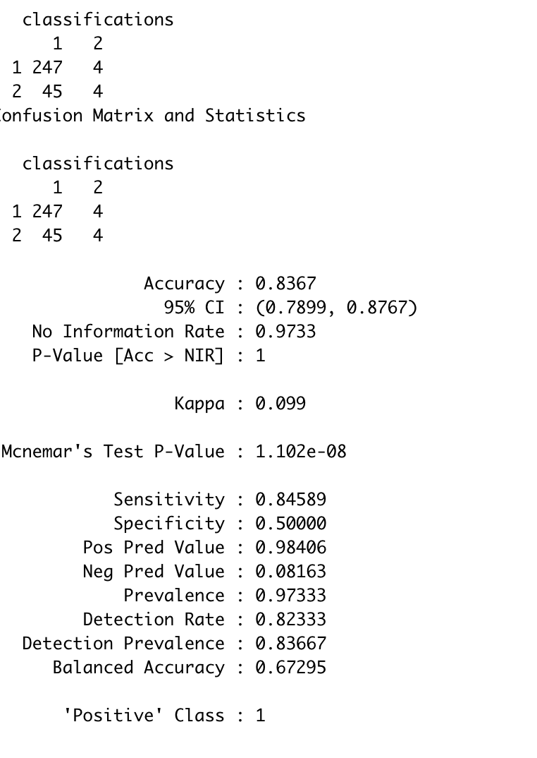
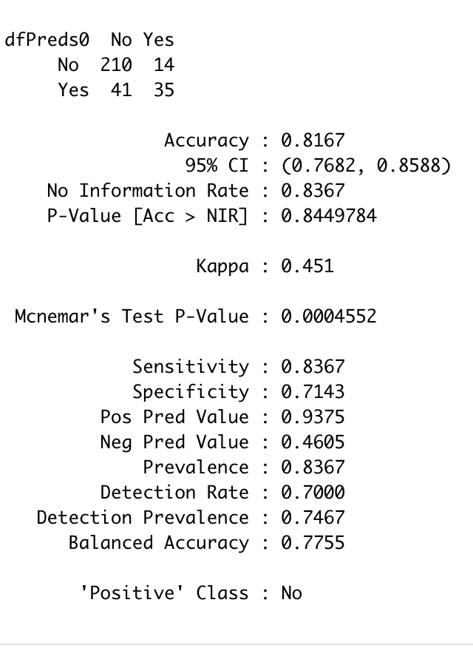
Various Models Tested for Attrition
Naïve Bayes Classification
Knn Classification

Slide 8
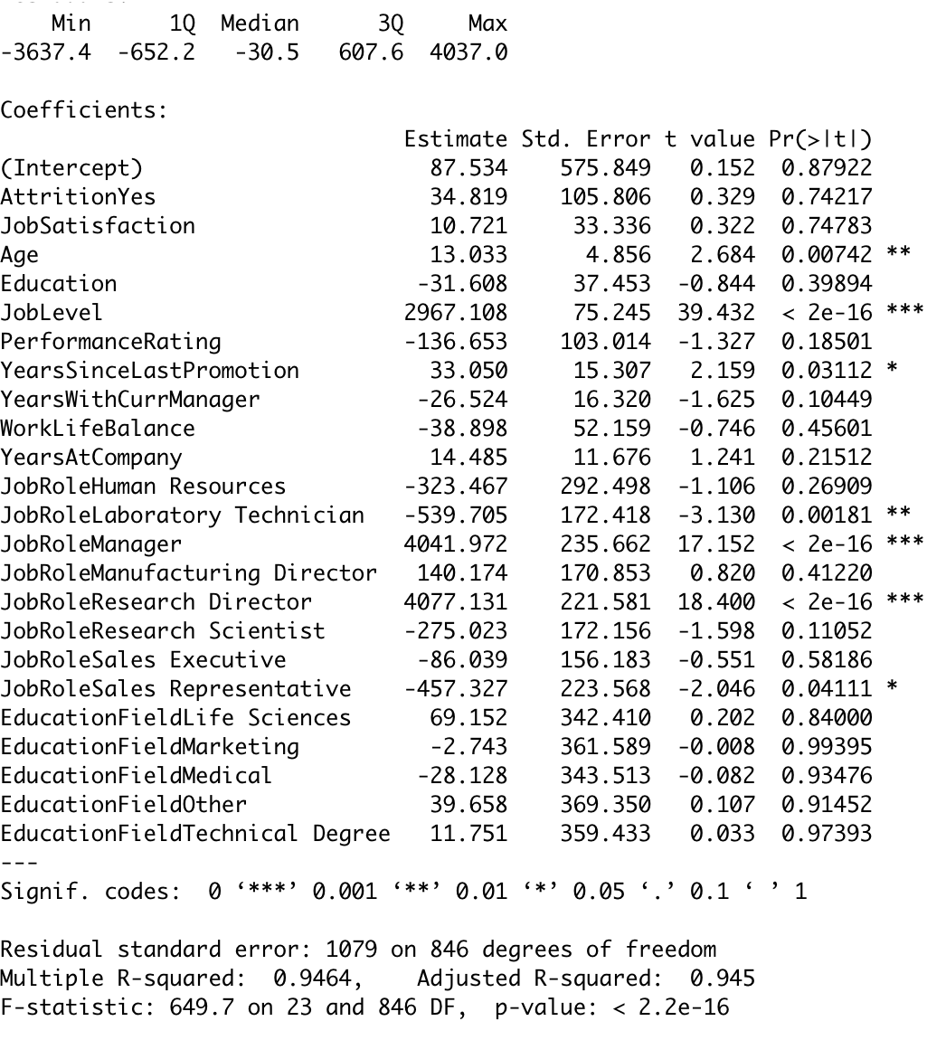
Multiple Linear Regression Model Used for Monthly Income Prediction
Multiple Linear Regression Model

Slide 9
Summary
Sales Representative seems to have the highest attrition, while Research Director has the lowest attrition %
Job level, age, years since promotion and years at company seems to have higher impact on monthly income
Job satisfaction, work life balance, years since last promoted seems to have the higher impact on the employee attrition
Employee making less that $5000 have highest attrition
Using Naïve Bayes with 81% accuracy we were able to identify employee attrition
With Adjusted R square 0.945 and RMSE < $1100 we were able to predict monthly income

